Slide 1

FINANCIAL NEWS RAG
WITH SENTIMENT ANALYSIS
GenAI Capstone Project
By Jack Park, Irene Xu, Christina Han
CONFIDENTIAL & PROPRIETARY
STRATEGIC INTELLIGENCE // 2026

Slide 2

PROBLEM & CUSTOMER CONTEXT
MARKET PROBLEMS
TARGET USERS
Financial news is fragmented and high-volume. Investors struggle to extract relevant insights quickly.
Portfolio managers, Quant researchers, Macro investors
TRADITIONAL TOOLS LACK:
MINI EXAMPLE
semantic understanding
real-time summarization
Example query: “What is happening with Meta lately?”
sentiment interpretation
PROBLEM:
Need to read 20+ articles manually to get a comprehensive view.
GOAL
Convert raw news → actionable insights

Slide 3
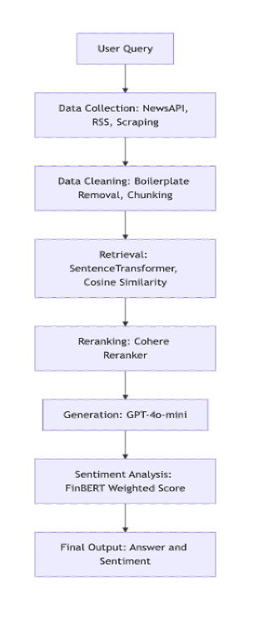
PROPOSED ARCHITECTURE
PIPELINE COMPONENTS
Data collection (API + RSS + scraping)
Data cleaning and chunking
Embedding-based retrieval
Reranking (Cohere)
Generation (LLM)
Sentiment analysis (FinBERT)
KEY DESIGN CHOICES
Modular pipeline for interpretability
Retrieval + reranking separation
Sentiment added post-generation

Slide 4
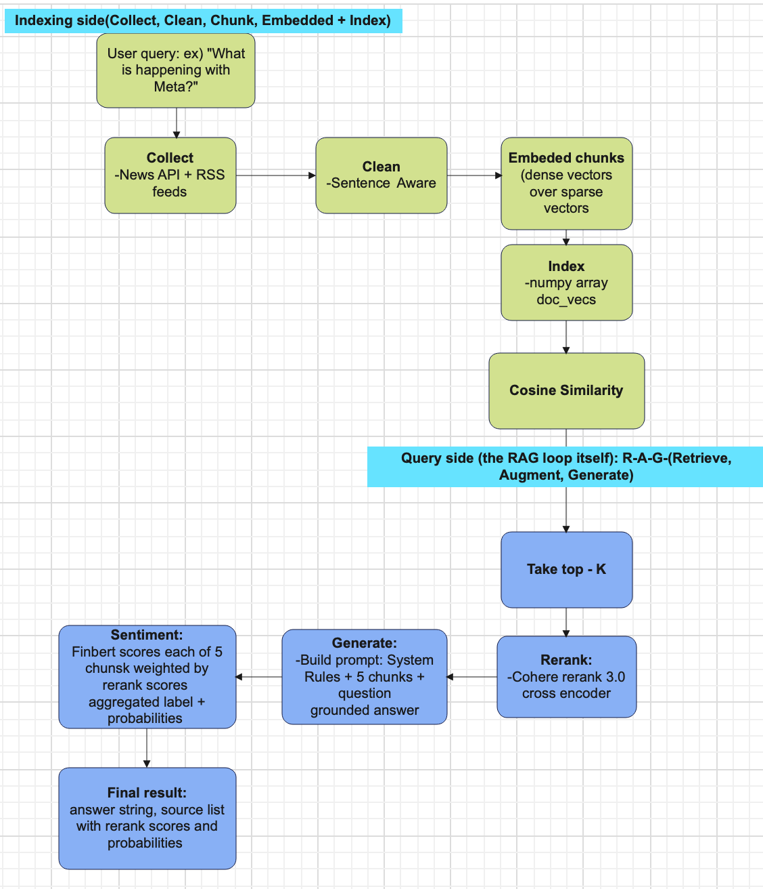
BACKEND SYSTEMATIC
ARCHITECTURE
PIPELINE BREAKDOWN
Indexing
Collect → Clean → Chunk → Embed
Retrieval
Cosine similarity → Top-K selection
RAG Loop
Rerank → Generate → Sentiment
KEY DESIGN DECISIONS
In-memory vector index (NumPy)
Two-stage retrieval (embedding + reranking)
Modular architecture for flexibility
Post-generation sentiment for interpretability
KEY INSIGHT
Retrieval quality determines generation quality

Slide 5




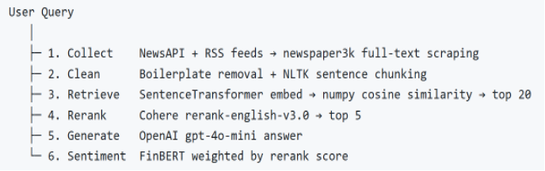
WHAT WAS ACTUALLY BUILT
CORE SYSTEM STATUS
IMPLEMENTED MODULES
FULLY RUNNABLE PIPELINE
Multi-source data ingestion
End-to-end implementation delivering context-aware answers paired with weighted sentiment intelligence.
Text preprocessing and chunking
Embedding + similarity search
Reranking layer
LLM generation
OUTPUT FORMAT:
Query → Answer + Sentiment
Sentiment scoring

Slide 6







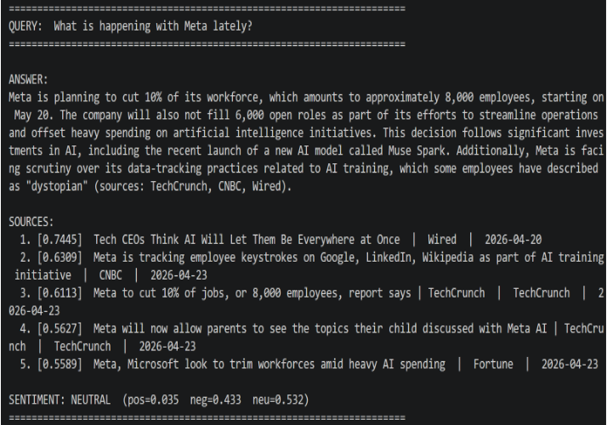
DEMO / PIPELINE WALKTHROUGH
INPUT
INGESTION
EMBEDDING
RETRIEVAL
SYNTHESIS
SENTIMENT
Input query (e.g., META news)
Collect and preprocess news
Convert into embeddings
Retrieve and rerank documents
Generate answer
Attach sentiment score
SYSTEM OUTPUT
Structured answer
Weighted sentiment

Slide 7

EXECUTION VS. PLAN
ORIGINAL PLAN
ACTUAL EXECUTION
Full system with vector DB
Focus on core RAG pipeline
In-memory processing
Frontend interface
Real-time pipeline
WHY THIS DECISION?
TRADE-OFFS
Limited time → focus on core functionality. Goal: ensure end-to-end system works reliably.
Simplicity
Scalability
Dev Speed

Slide 8

TECHNICAL CHALLENGES
CHALLENGES
SOLUTIONS
API LATENCY (MULTIPLE CALLS)
Added reranking layer
NOISY RETRIEVAL RESULTS
Introduced logging
INCONSISTENT SCRAPED DATA
Simplified architecture
PIPELINE INTEGRATION COMPLEXITY
Tuned retrieval parameters

Slide 9
VALIDATION & RESULTS
EVALUATION APPROACH & FINDINGS
Qualitative analysis of outputs (relevance & coherence)
Reranking significantly improves retrieval precision
Sentiment scoring adds critical interpretability layer
LIMITATIONS
Some irrelevant documents remain in top-K
Latency still noticeable due to multiple API calls
CONCRETE OBSERVATION
WITHOUT RERANKING
WITH RERANKING
Noisy results with fragmented context
More focused and contextually accurate answers

Slide 10

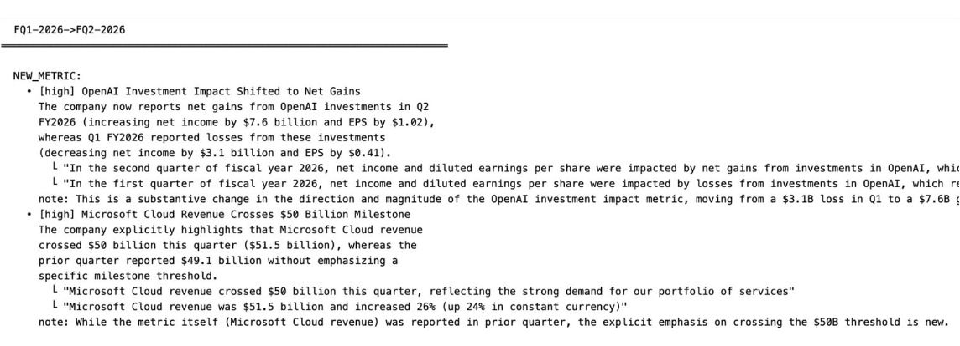
CHANGE DETECTION: TECHNICAL FRAMEWORK
Semantic Retrieval / Inverted retrieval Direction
Verbatim (words identical sent to LLM) to reduce error
Novelty(c) = 1 - max cos(c, c')
where c' ∈ quarter N-1
Autonomous RAG / Self-Retrieval RAG
The system decides what is worth retrieving without having a human giving a prompt driven by internal signal (novelty).
Pipeline computes novelty score
Pairs prior chunks for comparison
Provides synthesized result to LLM
- Ghafouri et al. (2025)
- Saha, A., et al. (2025). BlackRock LLM agents survey.

Slide 11
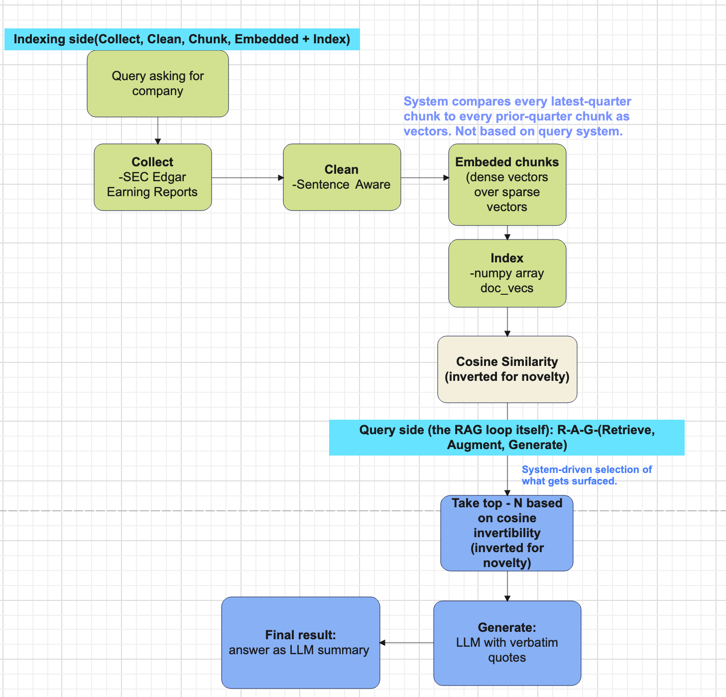
CHANGE DETECTION: TECHNICAL FRAMEWORK
RETRIEVAL STRATEGY
NOVELTY COMPUTATION
Semantic Retrieval / Inverted retrieval Direction
Novelty(c) =
1 - max cos(c, c')
where c' ∈ quarter N-1
Verbatim (words identical sent to LLM) to reduce error
Autonomous RAG / Self-Retrieval RAG
Pipeline computes novelty score
Pairs prior chunks for comparison
Provides synthesized result to LLM
The system decides what is worth retrieving without having a human giving a prompt driven by internal signal (novelty).
- Ghafouri et al. (2025)
- Saha, A., et al. (2025). BlackRock LLM agents survey.

Slide 12





KEY TECHNICAL RISKS
SYSTEM RISKS
MODEL RISKS
SCALABILITY
RETRIEVAL NOISE
In-memory design limits processing capacity for massive datasets.
Potential for irrelevant documents to dilute generation quality.
API DEPENDENCY
SENTIMENT AGGREGATION
Heavy reliance on external providers for embeddings and generation.
Simplified scoring logic may overlook nuanced market signals.
LATENCY ISSUES
Sequential processing of multiple API calls impacts real-time performance.

Slide 13

NEXT TECHNICAL STEPS
PHASE 01
PHASE 02
PHASE 03
SHORT-TERM
MID-TERM
LONG-TERM
Add vector database
(FAISS / Pinecone)
Add evaluation metrics
Real-time streaming system
Multi-language support
Improve sentiment aggregation
Optimize retrieval pipeline

Slide 14

KEY TAKEAWAYS
CORE FINDINGS
TECHNICAL INNOVATIONS
RAG works well for financial news synthesis
SEMANTIC RETRIEVAL
Reranking is critical for quality
Inverted retrieval direction using verbatim text to minimize synthesis errors.
Sentiment adds decision value
NOVELTY FORMULA
Novelty(c) = 1 - max cos(c, c') for quarter-over-quarter change detection.
Trade-offs between speed and scalability
AUTONOMOUS RAG
Self-retrieval system driven by internal novelty signals without human prompting.

Slide 15

Q&A
FINANCIAL NEWS RAG WITH SENTIMENT ANALYSIS
STRATEGIC INTELLIGENCE // 2026

